Slide 1

Some everyday challenges for women in recovery from addiction
Action on Addiction Annual Research Seminar
15th March 2013
Jo Neale

Slide 2
Part 1:
IS RECOVERY DIFFERENT FOR WOMEN?

Slide 3
What is recovery?
“Recovery from substance dependence is a voluntarily maintained lifestyle characterized by sobriety, personal health, & citizenship.” Betty Ford Institute (2007)
“The process of recovery from problematic substance use is characterised by voluntarily-sustained control over substance use which maximises health & wellbeing & participation in the rights, roles & responsibilities of society.” (UKDPC, 2008)
Recovery…
  Is not simply about drug use
  Is about individuals achieving benefits in a wide range of life areas, including relationships, housing, health, employment & offending
  Should enable everyone to have aspirations, feel that they are part of society & lead more fulfilling lives

Slide 4
Gender theory
Era | Focus | Assumptions
First wave feminism | Women’s right to vote, legal obstacles to gender equality | Patriarchal structure of society Essential differences between women & men All women share common experiences Essential ‘we’ of womanhood
Second wave feminism | Sexuality, reproduction, the family, the workplace, male violence
Third wave feminism | Personal experience, individual agency, diversity, choice, change | Critique of ‘essentialist’ definitions of femininity Some women share political & economic interests with some men Women have diverse experiences

Slide 5
Women & drugs literature
Era | Focus
First addiction literature | Ignored women or portrayed them as ‘bad’, ‘mad’, or ‘sad’
Early feminist literature on women & drugs | Highlighted women’s shared experiences of addiction (focused on sex work, sexual relationships, pregnancy/ mothering, abuse) Highlighted barriers to accessing services faced by women Highlighted the need for specialized women’s services
Later feminist literature | Identified women’s diverse needs & experiences Showed similarities between male & female drug users Located women’s drug use in terms of choice, pleasure seeking & self-fulfillment

Slide 6
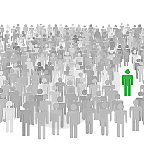
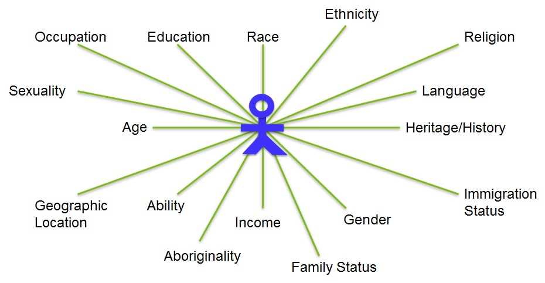
Key debates
Similarities v Differences
Structure v Agency

Slide 7
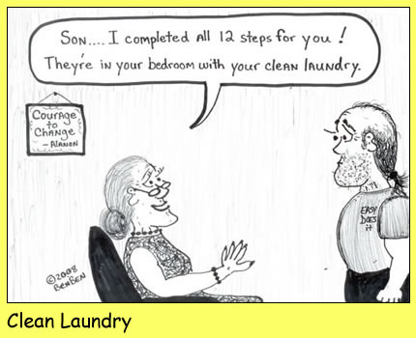

Slide 8
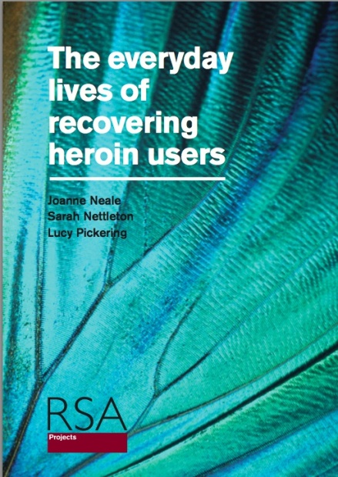
The everyday lives of recovering heroin users study
Funder: the ESRC
PI: Jo Neale
CI: Sarah Nettleton
Researcher: Lucy Pickering
Broad aim: to move away from preoccupations with heroin use as a deviant & risky activity &, instead, focus on the routine & everyday aspects of recovering heroin users’ lives

Slide 9

Methods
Stage 2: 40 interviews with recovering heroin users to explore their daily lives (21 men; 19 women; ages 24-50 years; 38 White British)
Stage 3: 37 follow-up interviews to explore how their recovery journeys were progressing (20 men; 17 women)
Participants included 10 starting OST; 10 starting detox; 10 starting rehab; & 10 opioid free for longer than 2 months
Interviews were semi-structured, digitally recorded, professionally transcribed, coded using MAXQDA, & analysed using Framework (Ritchie & Spencer, 1994)

Slide 10
Some everyday challenges
(Re)building relationships
Detoxing, craving, (re)lapsing
Filling the void
Emotional changes
Day-to-day self-care
Poor health
Bodily changes
Keeping house

Slide 11
Detoxing, craving, (re)lapsing
“It scares you, when you come off your methadone. Because you think, ‘How am I going to cope? What am I going to do then?’… I’m like thinking, ‘Can I do it?’” (Bess, aged 31)
Fear of the detoxing process
Cravings for other substances & behaviours
Avoiding ‘using triggers’
Relapse and cross-addiction
“I am worried about it [detoxing]. I don’t think anyone likes the misery or pain, or to feel cold, to feel ill. So I’ll find out what it’s like… Hopefully, I won’t be flying off the walls &… throw myself on a train & come back… & score…. Hopefully, I’ll stick it out.” (Neil, aged 37)

Slide 12
(Re)building relationships
Frequent strained family relationships
Intimate relationships complicated by addiction
Separation from children
Few genuine friends
“I feel like Billy-no-mates some of the time. Whereas there’s always people to hang around with when you’re using.” (Nathan, aged 30)
“Never had friends really. I’ve had acquaintances. They’ve all been smack heads, same as me, & they ain’t what you call friends… They’re just addicts.” (Sorayha, aged 31)

Slide 13
Emotional changes
A spontaneous flood of (often intense & uncontrollable) returning emotions
Yo-yoing emotions
“I didn’t realise that all these emotions were going to come back… like feelings were going to come back.” (Isabelle, aged 35)
“When I stopped drugs this time, all my emotions were just all over the place. I was just like, yeah, up & down. Just my head was spinning out &… I’d go into anger quickly & then one minute I’d start crying. I was like, ‘What’s going on here?’” (Stefan, aged 27)

Slide 14
Poor health
“I can hear myself wheezing sometimes. You ever had it where it whistles when you breathe...? I get that, but from my chest, not just from me nose.” (Nathan, aged 30)
Physical health
  BBVs, collapsed veins & abscesses
  Chest & lung complaints
  Toothache
  Drug-related injuries
  General health problems
Mental health
  Depression, anxiety, mood swings, paranoia, self-harm, suicidal ideation
“My breathing has not always been the best, & being a smoker as well. And plus with the drug abuse & all the other abuse that goes in my mouth, or comes out of it.” (Fiona, aged 49)

Slide 15
Day-to-day self-care
Sleeping well
Eating regularly
Personal hygiene
“I’m a lot better than when I was using drugs, but I don’t like getting up & showering in the morning... I try & be hygienic & get my clothes washed & stuff. It doesn’t come naturally to me at the moment… I’m not very domesticated in that kind of area, but I’m trying my best.” (Frances, aged 31)
“Once a week I sit there with a sauna thing on my face, maybe even a face mask, whatever I feel like at the time, you know. Pamper myself a little bit, which again I wasn’t doing that because [of] the drugs. Everything was neglected.” (Fiona, aged 49)

Slide 16
Keeping house
“When I lapse, they [domestic chores] get worse. When I don’t use, I get in quite a good routine around the house & stuff. But as soon as I’ve lapsed for a few days, everything goes to pot.” (Louise, aged 34)
Securing a stable home
Ensuring a regular income
Managing money & paying bills
Doing housework
“My washing machine used to go on once a month, all day. Whereas now it goes on once a week, two loads once a week… So I’m getting better, getting a bit of balance in there.” (Stewart, aged 50)

Slide 17
Filling the void
“When you stop taking drugs, you’ve lost that thing you’re doing. So really you need to replace it with something to do. Otherwise [it’s] a big void of nothingness.” (Toby, aged 45)
Boredom
Worries about the future
“If I let my head run away with me, it’s a very scary place… If I allow myself to go too far, then it is very scary, & I don’t know what I’m scared of.” (Vicki, aged 45)

Slide 18
Summary so far…
Recovery brings many challenges
Women & men encounter many of the same challenges
Women do not all experience the same challenges
Recovery is affected by complex interacting factors, including:
    Individual biographies
    Access to formal & informal support
    Drug use & stage of recovery
    Physical health
    Mental health
    Prescribed medications
    Emotions
    Knowledge & skills
    Having meaningful activity or daily routines
    Housing/ environment
    Income & material resources
So what is the role of gender?

Slide 19
Part 2:
WHEN AND HOW IS RECOVERY DIFFERENT FOR WOMEN?

Slide 20
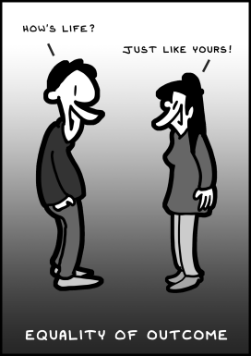

Slide 21
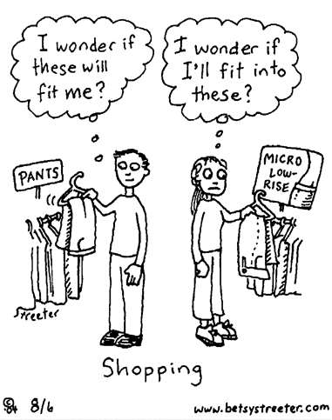

Slide 22
Relationships
Men | Women
‘Unhappy’ childhoods | Childhood physical & sexual abuse
Lack of family support | Physical violence from spouses/ partners
Non resident children | More children (& a small number had resident children)
Difficulty making new non-using friendships | Concerns about parenting
Reliance on NA for friendships | Children motivate recovery
Social isolation | Practical & emotional support from relatives
 | Ability to isolate self from drug users & make new non-using friendships

Slide 23
“[Partner] put a gun to me… I still didn’t phone the police on him. Me mum phoned the police & I dropped the charges… He got machetéd a few weeks after he put the gun to me head & he was in intensive care.” (Sorayha, aged 31)
“See the longer they [children] are with my mum as well, the harder it is, you know. Because they do look upon my mum now as their mum… They like say things to me like ‘Nan, I mean Mum’. And then they’ll call my mum ‘Mum’… It’s little things like that. I think, ‘Well, maybe they don’t want to come back with me’.” (Bess, aged 31)
“I don’t want to rush into anything full-time [having the children back living with her] straight away. Because I don’t want to just suddenly go, ‘Oh my God, I can’t cope’.” (Lauren, aged 27)
“If my kids hadn’t been taken off me, I think I’d still be in the same situation. I mean hopefully this [going into residential treatment] is all gonna be for the best and it will make everything better.” (Diane, aged 34)

Slide 24
Poor health
Men | Women
Injuries from drug-related assaults, car accidents & fighting | Self-harming, suicidal thoughts & actual suicide attempts
“Around the time when my first boyfriend, Daniel, finished [with me], that’s when I discovered self-harm. That carried on all the way through, to the present day. It was just anything that could make this feeling, the feeling, the empty feeling I’m feeling, I’ve got, go away.” (Debbie, aged 28)
“I’d just had enough. And I needed a release, because I didn’t want to use… Just got a knife & split my hand open. Took me to hospital… They couldn’t put stitches in it, because… it had been open for so long, which is why it [the scar] is so big.” (Lauren, aged 27)

Slide 25
Bodily changes
Men | Women
Happy to put on weight | High levels of anxiety about increased weight – triggering eating disorders & relapse
Libido | Menstruation
“I’ve put on weight already, which is amazing… The comments saying, ‘Oh God, you’re looking good, you’re looking healthy’, that gives me motivation, severe motivation. [I] even had somebody come up to me yesterday & said, ‘Do you want to start doing sport again?’ And that’s given me motivation.” (Liam, aged 37)
“The last few weeks, I feel that I’ve put on too much weight… I’d be happy to lose half a stone I reckon & then I’ll be OK. No, actually I want to be lighter than that. See what I mean? I’m never going to be happy.” (Bess, aged 31)

Slide 26
Eating disorders
“I felt really fat then… I’d want to [eat], but I was making myself sick then as well really. Because I was desperate to lose the weight.” (Leah, aged 38)
“I get cravings more for being sick than I do for [heroin]… At least once a day I think, ‘I could just vomit all the food back up’.” (Chrissie, aged 24)

Slide 27
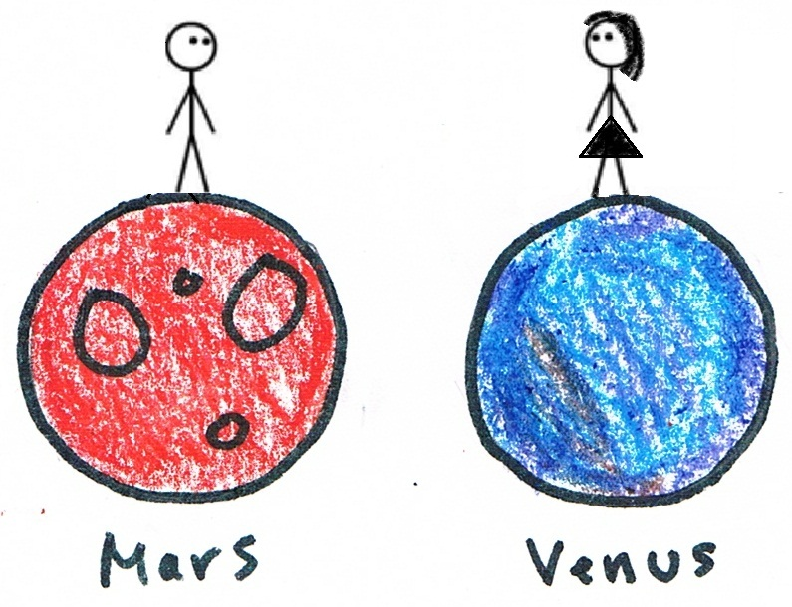

Slide 28
Libido
“Throughout my heroin use there was no real desire for sexual intimacy. A lot of people talk about it [libido] coming back with a vengeance when they stop using, but I haven’t experienced that really. It’s much more than it was, but that’s still not rampant.” (Charlie, aged 31)
“I’m more lively downstairs than I have been in a long, long, long time.” (Luke, aged 34)
“I haven’t had sex for about five, six years now. It doesn’t bother me, sex. It doesn’t bother me at all… I’m not really bothered about sex, to be honest. I’m more interested in getting my life back on track.” (Ellie, aged 29)
“When I stopped using? Yeah, you're, yeah, like a dog on heat, aren't you?” (Stefan, aged 27)

Slide 29
Menstruation
“I just don’t like them, stomach cramps. Fucking hell. Where before I never used to get, because you didn’t even get stomach cramps or anything, but now I do get real bad stomach cramps, which is not nice.” (Annabel, aged 29)
“I've been looking in the mirror & looking so old. I was thinking, ‘Oh God, it’s gonna get ten times worse...’ And then I had a period & I thought, ‘That’s alright. The oestrogen is still going round - ain’t gonna become all dried up & shrivelled quite as soon as I thought’.” (Beth, aged 43)

Slide 30
Day-to-day self-care
Men | Women
Inability to sleep & early morning wakening | Excessive sleeping, including daytime sleeping
Fear of dentists/ inability to afford dentists/ dental work needed | Tooth brushing/ visits to the dentist/ recent dental treatment
Less concern with personal appearance | Increasing concern with personal appearance, including hair, nails, skin, make-up, clothes

Slide 31
“Oh, my hair’s doing my head in… I want it all chopped off… I can’t do anything with my hair. I can’t do anything with it, & all I do is just wear it up in a ponytail… If I had it cut short, then I’d be able to wear it down, wear it up, I’d be able to style it.” (Ellie, aged 29)
“My hair needs a bit of a bloody cut… I need to go and get my eyebrows waxed as well. And my bits [bikini line]… In rehab, you can’t do none of that.”(Debbie, aged 28)
“Because it’s dry at the moment, I’m washing it every other day, until I can get something for it & get it cut… It needs really fucking sorting out… It does need cutting because there’s loads of split ends in it… I was meant to get it cut before I come in here [rehab], but obviously didn’t… I was thinking of getting it cut & then having a few layers put in it. Do something nice for a change.” (Lauren, aged 27)

Slide 32
Keeping house
Men | Women
Homelessness (hostels, shelters, rough sleeping, sofa surfing) | More secure accommodation
Illicit income | Greater reliance on state benefits, family assistance & prostitution
Debts/ lack of budgeting skills | Better at paying bills
“The threat of homelessness [is a shock]. Because my old man… said, ‘If you use [drugs], you can’t stay’. And my cousin said it and my brother, so they all sort of said that.” (Neil, aged 30)
“I do worry what’ll happen when I get out of here [residential treatment], ‘cos I can’t budget & things like that”. (Nathan, aged 37)

Slide 33

Limitations
  Focus on heroin users
  Have not reviewed all possible challenges people experience in recovery
  Data may not fully capture the views & experiences of heroin users who have never received formal treatment
  Do not report on the barriers to accessing services
Do not claim statistically significant differences between women & men
  Women & men encounter many of the same challenges
Also, women have different experiences from each other
However, our data still highlight gender differences that require consideration in terms of service delivery

Slide 34
DORIS
1,033 individuals beginning a new episode of drug treatment in 2001/02
  715 (69%) male
  318 (31%) female
Recruited from 33 agencies in rural, urban & inner-city Scotland
Structured questionnaire to collect data on drug use & more general life issues
Neale, J. (2004) 'Gender and illicit drug use', The British Journal of Social Work 34, 851-870.

Slide 35

DORIS: Personal relationships
 | Males (n=715) % yes | Females (n=318) % yes
Physical abuse by relative or family friend*** | 16 | 27
Sexual abuse by relative or family friend*** | 7 | 25
Physical abuse by a partner*** | 10 | 51
Sexual abuse by a partner*** | - | 15
*p<0.05; **p<0.01; ***p<0.001

Slide 36
DORIS: Health
 | Males (n=715) % yes | Females (n=318) % yes
Ever attempted suicide*** | 28 | 49
Ever deliberately self-harmed*** | 20 | 38
*p<0.05; **p<0.01; ***p<0.001

Slide 37
DORIS Housing
 | Males (n=715) % yes | Females (n=318) % yes
Lived in hostel or shelter in last 6 months | 16 | 16
Slept rough in last 6 months*** | 18 | 9
*p<0.05; **p<0.01; ***p<0.001

Slide 38
DORIS Offending
 | Males (n=715) % yes | Females (n=318) % yes
Sold or supplied drugs in last 3 months* | 35 | 27
Assault in last 3 months*** | 22 | 10
Theft from a house in last 3 months*** | 12 | 4
Soliciting in last 3 months*** | 1 | 10
*p<0.05; **p<0.01; ***p<0.001

Slide 39
DORIS: Conclusions from 2004
There are important gender differences between drug users entering treatment, but
Gender differences are not always evident
Male & female drug users entering treatment share many common problems
There are many differences between individuals of the same sex

Slide 40
Part 3:
WOMEN AND RECOVERY CAPITAL

Slide 41
Summary so far…
Detoxing, cravings, (re)lapsing; relationships; emotional changes; bodily changes; poor health; day-to-day self-care; keeping house; filling the void; thinking about the future
Sex/ gender
Challenges
Interacting factors
Individual biographies formal support; informal support; personal relationships; drug use; stage of recovery; physical & mental health; prescribed drugs; emotions; knowledge & skills; meaningful activity; daily routines; income & material resources; housing & environment

Slide 42
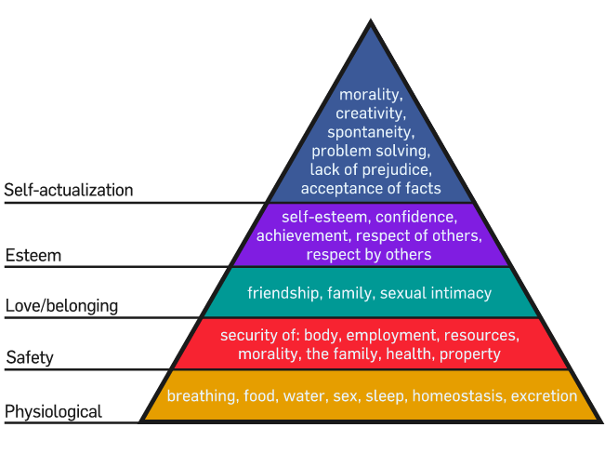
Implications so far…
The meaning of recovery
  Recovery is not simply about drug use; it involves achieving benefits in a wide range of life areas, including relationships; housing; health; employment; & offending
  But also…
  Sleeping; diet/ nutrition; weight; appearance; libido; emotions; day-to-day self-care; having meaningful activity; domestic skills; securing income; managing money; having plans for the future; living in a secure environment etc.
Maslow, A H (1943) “A Theory of Human Motivation.” Psychological Review ,50, pp 370-396.

Slide 43
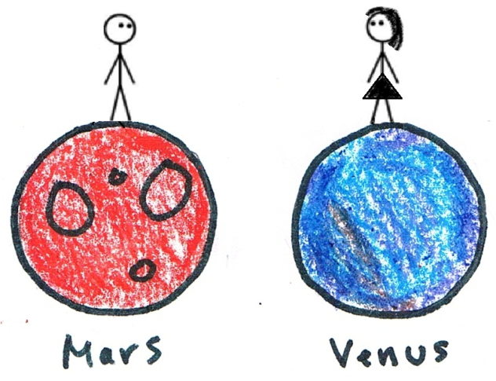
Implications so far…
Gender theory & the literature on women & drugs
  Women & men encounter many of the same challenges
  Not all women share the same challenges – women can have very different experiences
  Challenges are affected by gender
  But challenges are also affected by complex interacting biological; psychological; economic; social; & cultural factors

Slide 44
Recovery capital
Cloud, W. & Granﬁeld, R. (2008) ”Conceptualising recovery capital: expansion of a theoretical construct”. Substance Use and Misuse, 43 (12–13): 1971–1986.
Social capital (relationships & social networks)
Physical capital (income, savings, investments, property, tangible financial assets)
Human capital (education, knowledge, skills, hopes, aspirations, health, heredity)
Cultural capital (values, beliefs, attitudes that link to social conformity)

Slide 45
Negative recovery capital
“Discussions of recovery capital in our previous writings implied that it existed on a continuum from none (or zero) to large amounts… A more useful conceptualization of recovery capital might be to think about it as … a positive and negative continuum. There are situations where recovery capital can be seen as resting on the minus side of zero —negative recovery capital.”
For women:
more destructive physiological effects of regular ‘heavy’ substance misuse
greater social taboos against women with drug problems
higher rates of mental health problems
elevated levels of abuse and extreme violence
emotional scars accumulated through prostitution
Cloud, W. & Granﬁeld, R. (2008) ”Conceptualising recovery capital: expansion of a theoretical construct”. Substance Use and Misuse, 43 (12–13): 1971–1986.

Slide 46

Social capital
Low for our male & female participants
Consistent with the literature, women were more likely to report physical/ sexual abuse in childhood & violence by partners as an adult
However, women had more informal support than the men
Women found it easier to establish new non-using friends
Women were more likely to state that children motivated abstinence

Slide 47

Physical capital
Male & female participants reported few resources
Women received more material support, including housing, from family
Women were less likely to be homeless

Slide 48
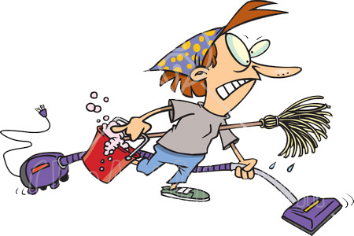
Human capital
Men & women had limited education & work experiences
Men & women had similar modest hopes & aspirations
Men & women reported poor mental & physical health, although they highlighted different types of health problems
There was considerable individual diversity in relation to domestic skills, although women seemed better at budgeting

Slide 49
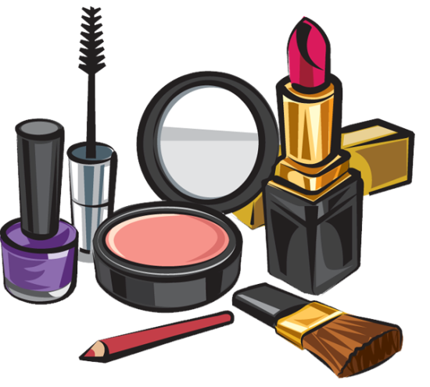
Cultural capital
Men & women repeatedly expressed a desire to be ‘normal’
There was considerable individual diversity in terms of the extent to which participants prioritized personal hygiene and self care
Women were more concerned with outward appearances, especially weight

Slide 50
Is Cloud & Granfield’s model of recovery capital useful?
Yes, but…
  Cultural capital might be negative, especially for women
  Physical capital seems to be misnamed
  Human capital seems to have too many components
  Health capital could be a separate category
Social capital (relationships & social networks)
Financial capital (income, savings, investments, property, tangible financial assets)
Human capital (education, knowledge, skills, hopes, aspirations)
Cultural capital (values, beliefs, attitudes that link to social conformity)
Health capital (physical health, mental health, basic physiological functioning, heredity)
Social capital (relationships & social networks)
Physical capital
(income, savings, investments, property, tangible financial assets)
Human capital (education, knowledge, skills, hopes, aspirations, health, heredity)
Cultural capital (values, beliefs, attitudes that link to social conformity)

Slide 51
“Yet if a woman never lets herself go, how will she ever know how far she might have got? If she never takes off her high-heeled shoes, how will she ever know how far she could walk or how fast she could run?”
Germaine Greer

Slide 52
Conclusions
Recovery capital tends to be low for males & females
Recovery resources vary by individual
We cannot assume women have less recovery capital than men
Cultural capital can be negative, especially for women
Women are likely to have particular support needs in recovery
We need to enable both men & women to maximize their recovery capital & achieve their recovery potential
And we need to remember that many of the challenges faced by people in recovery are common to other people too
And, so finally …

Slide 53

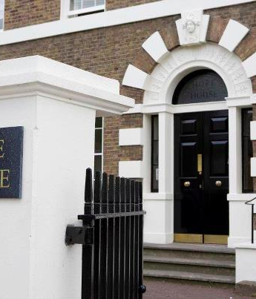
Clouds or Hope?
An all-female environment isn’t right for everyone, but
Is right for some people at certain points in their lives
An all-female environment can offer a safe & supportive place to:
  Work through complex issues
  Address emotional, physical, educational & recreational needs
  Benefit from the encouragement & support of professionals & peers
  Nurture confidence & self-esteem
  Share aspirations, strengths, talents & resources

Slide 54

Acknowledgements
Co-researchers: Sarah Nettleton & Lucy Pickering
Economic and Social Research Council: for funding the study
40 research participants: for giving their time & sharing their views & experiences
Service providers: for assisting with study recruitment
Action on Addiction (especially Amanda Thompson): for organising today’s seminar
Eversheds: for funding today’s seminar
Nick Barton: for suggesting today’s focus on gender

Slide 55
For discussion
Are there any additional everyday challenges for women in recovery?
Should we provide women only services?
Should we provide men only services?
What type of women only (& men only) services should we provide?
What kinds of support do women particularly need in recovery? Is this different for men?
How can we help both men & women to develop positive recovery capital?

